Slide 1
Complete Model
Torque In (base on scenario in each test case)
Steering wheel angle
Vehicle speed
Trajectory of vehicle (in meter)
Vehicle mass
Kingpin and caster angle

Slide 2
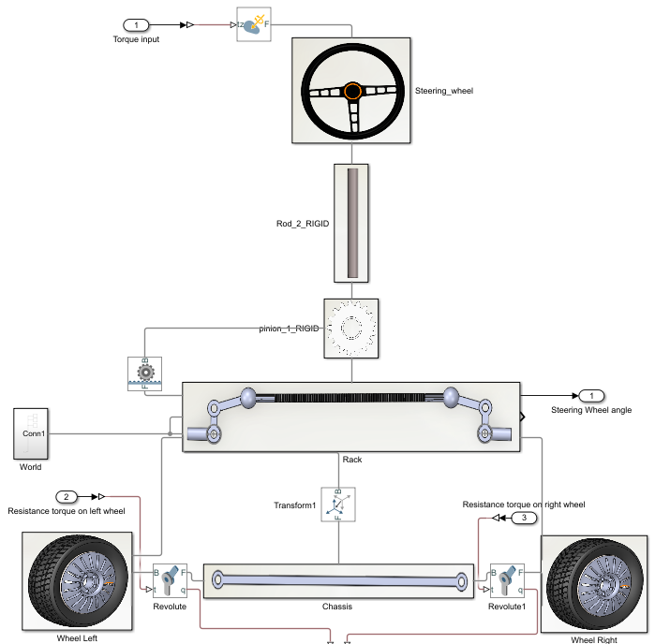
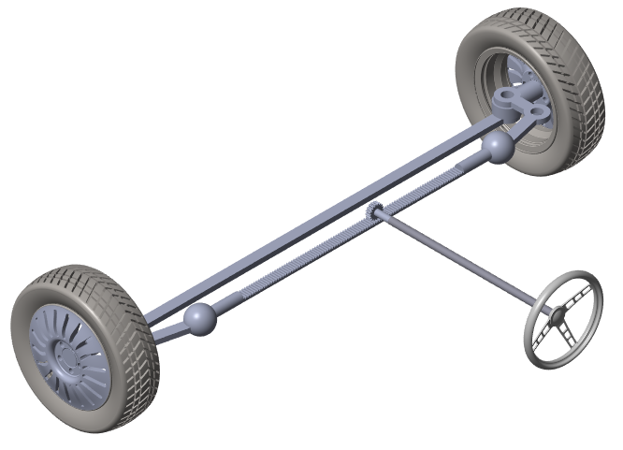

Slide 3
Steering dynamic
Torque In (base on scenario in each test case)
Steering wheel angle
Resistance torque
Steering angle at two front wheel

Slide 4
Get parameters from automotive workshop
Test cases
1km/h
Compare to real vehicle testing
Build 3D model on Solidworks
Import to Simscape
5km/h
Lane-changing scenario

